Slide 1

Asynchronous Development in ES6
Notes:
Presenter
2014-07-17 14:41:40
--------------------------------------------
Hello, and welcome to the module on Asynchronous coding with ES6.
This module is going to be one of the more difficult modules conceptually. Asynchronous coding is never simple, so you’ll want to put on your thinking cap.
In this module I don’t use traceur at all. All the demos are done with chrome. But again, by the time you watch this, other browsers may support all the functionality, so be sure to try it in your favorite browser.

Slide 2
Callbacks
Call Stack
Caller
Async Process
Callback
Notes:
Presenter
2014-07-17 14:41:40
--------------------------------------------
We’ll start out by taking a quick look at promises in the abstract. This is not meant to be a comprehensive look at what promises are, or how they work, but instead be a quick guide to the basics of what they are. The next section will look specifically at how to use ES6 promises.
The most basic form of asynchronous programming with javascript is the callback. In this scenario, A caller spawns some kind of asynchronous operation. Maybe a timer or an XHR call. When the caller initiates the asynchronous process, it passes a callback to the process, trusting that when the process finishes, it will invoke the callback. At some point in the future, the asynchronous process finishes, at which point the callback is put onto the call stack, and then it will execute whenever all the other process ahead of it on the call stack are complete. There’s some problems with this method. First, only the caller can get notified that the asynchronous process has completed. No other interested party can take an action when the process completes unless the callback itself notifies the other interested parties. Secondly, error handling is difficult. Also, dealing with several asynchronous processes at the same time is extremely difficult to manage. It’s up to the callbacks themselves to manage this.
Finally, the callback is responsible for multiple things in this scenario. It has to process the results of the async call, plus it has to kick off any other processes that want to execute based on the result of the async process. This dual responsibility is another source of pain with callbacks. Let’s look at an example.

Slide 3
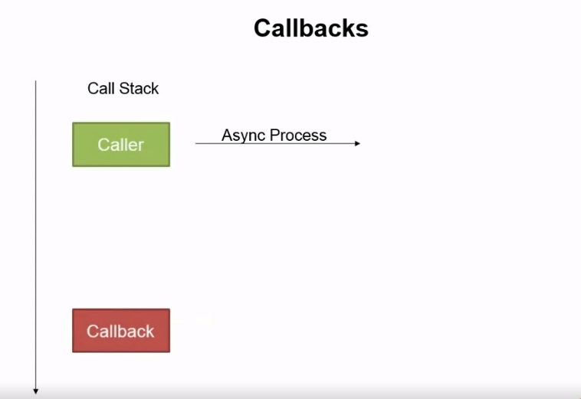

Slide 4
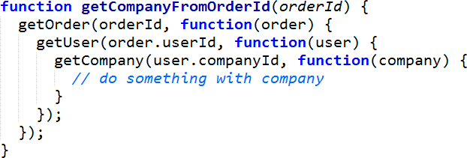
Callback Example
Notes:
Presenter
2014-07-17 14:41:40
--------------------------------------------
In this example, we are looking up a company based on an order ID. So first we get the order, then when that is complete, we can get the user, then when that is complete we can get the company. Obviously this level of nesting is undesirable. Notice how each callback has to not only process the data by calling the appropriate next function, but it also has to pass in an appropriate callback into the next function. So each callback is not only handling processing, but also flow control.

Slide 5
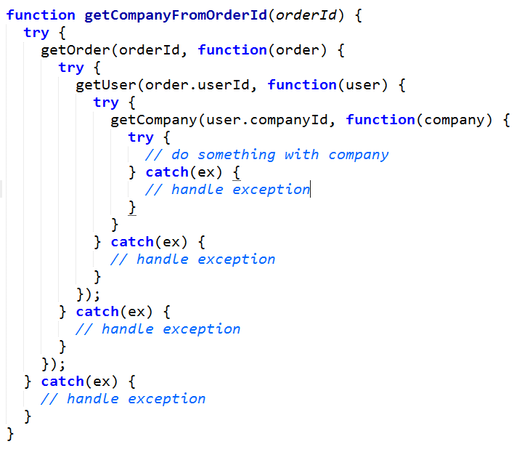
Callback Example
Notes:
Presenter
2014-07-17 14:41:40
--------------------------------------------
And when we add exception handling it gets even worse. This may seem unnecessary, but remember that each callback goes onto the call stack separately from the caller. Because of that, any exceptions they throw aren’t caught by the original initiator of the async request. So this is very much necessary.

Slide 6
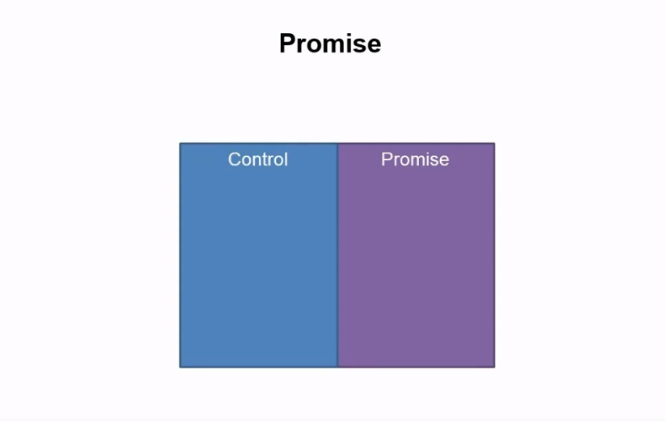

Slide 7
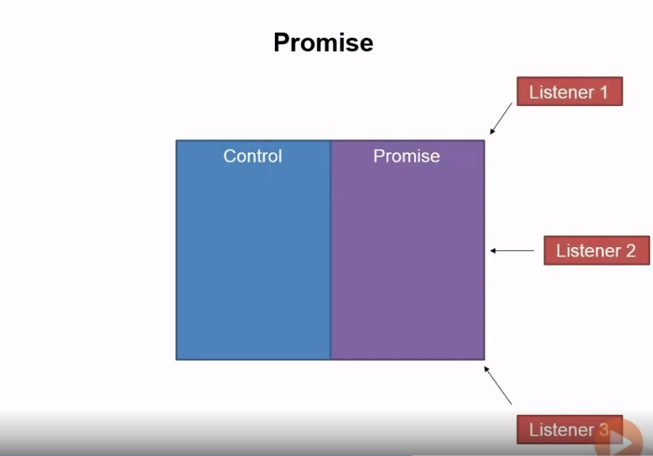

Slide 8
Promise
Listener 1
Control
Promise
Pending
Fulfilled
Rejected
Listener 2
Listener 3
Notes:
Presenter
2014-07-17 14:41:40
--------------------------------------------
So what’s the solution?
Promises have long been recognized as a solution to what is often known as callback hell.
A promise is an object which represents a handle to listen to the results of the async operation, whether it be succeeds or fails. In other words, the promise, “promises” to alert you when the async operation is done, and give you the results of that operation.
One of the main benefits of promises are that they are composable. You can take two promises, which represent two different asynchronous operations, and chain them together, so that one happens after the other. Or you can wait for them both to run, and then run a new operation when both are complete. You can make other promises that depend on the results of a previous promise, and succeeds when it succeeds, and fails when it fails. Another benefit of promises is that instead of relying on the callback to not only process the results, but also manage flow control, we can move that responsibility to someone else who will then compose the promises in the appropriate manner.
<B> A promise is actually made up of two parts. The first part is the control of the promise. In many libraries, this is called a deferred, and it is a separate object, in other implementations this is simply a callback itself. This gives the creator of the promise the ability to mark the promise as succeeded or failed. We’ll see more about this later on.
The second part is the promise itself. This object can be passed around <B> and enables interested parties to register listeners who can take actions when the asynchronous operation completes. That way flow control is no longer the responsibility of the same function which will handle the result of the operation, and therefore it can focus solely on doing its job, and others can worry about their own responsibilities. What’s even nicer is that the promise will also notify if the async process has a failure, so error handling is no longer swallowed up into the great asynchronous abyss of JavaScript call stacks.
<B>A promise exists in one of 3 states: Pending, Fulfilled, and Rejected. Pending means that it hasn’t completed yet. Fulfilled means it has completed successfully, and rejected means it has failed somehow. Note that the rejected state now means that we’re no longer dealing with exception handling when something goes wrong, we’re dealing with a promise in a rejected state. So anyone who needs to take an action when a particular asynchronous call fails can take action, and call stacks no longer get in the way, and exceptions don’t just silently fire off and get forgotten. Let’s look at a code example

Slide 9
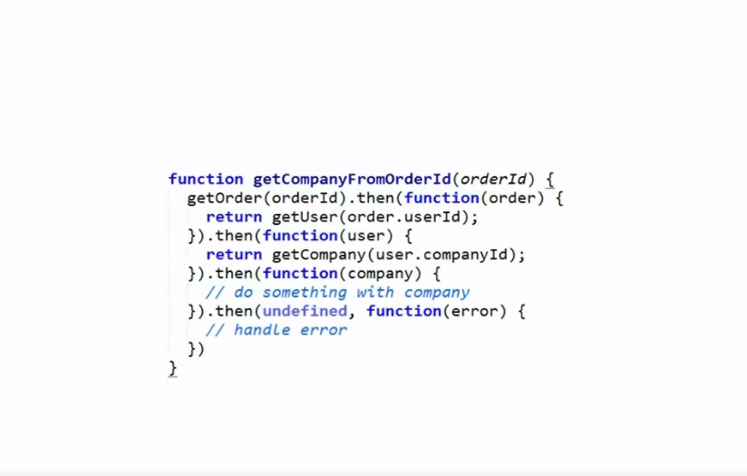

Slide 10
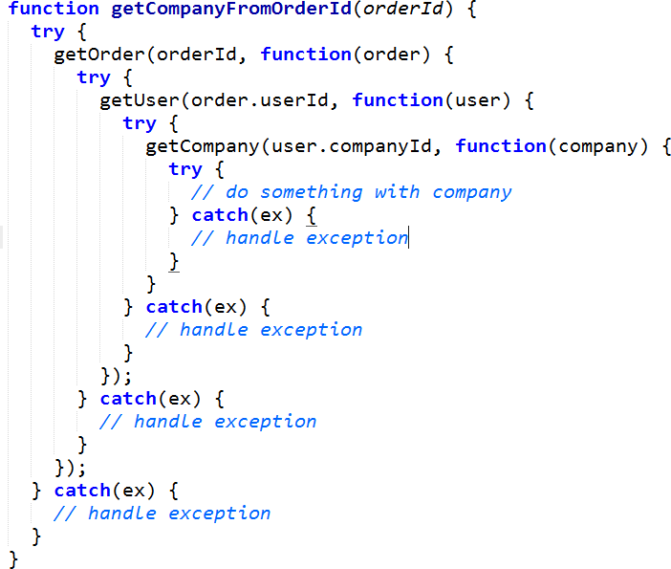
Notes:
Presenter
2014-07-17 14:41:40
--------------------------------------------
This is how our code looks using callbacks. Now let’s look at the same functionality with promises.
<B>

Slide 11
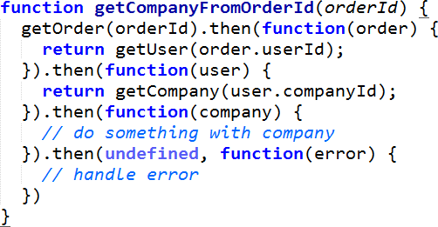
Notes:
Presenter
2014-07-17 14:41:40
--------------------------------------------
Let’s just take a quick moment to look at what this code is doing.
First, we call the getOrder function. This function is changed from before, now instead of using a callback to do everything, it returns a promise. Because of that, the callback can simply worry about handling the results of the call, and process the data.
When getOrder returns successfully, then this callback here is executed, which calls getUser, another async operation that returns a promise. When that returns, this callback here is called, which executes getCompany, which again returns a promise, thereby calling this callback here when it returns. Notice how on each call, the result of the call is passed into the next callback. getOrder returns an order. getUser returns a user. getCompany returns a company.
And finally, to handle any exceptions which are expressed by a failing promise, we call .then again, with the first parameter being undefined, and the second parameter a callback which will handle the failure. This code is significantly more readable than what we had before with all the callbacks.
This is pretty generic code. There are many existing promise libraries out there. Jquery, Q, rsvp, and now the promises built into ES6. This code will pretty much work with any of those. In the next section we’ll see exactly how to work with Promises in ES6.

Slide 12
Summary
Promises
Asynchronous Generators
Generators & Promises
Notes:
Presenter
2014-07-17 14:41:40
--------------------------------------------
In this module, <B>we saw how the new ES6 promises work, <B> then things got crazy when we saw how to use asynchronous generators to create asynchronous code that looked like synchronous code, <B> and then finally, we got really freaky when we put promises and generators together, but the result was some pretty nice looking code that was a lot more readable than any other alternative for asynchronous code. Regardless of their complexity, the power and elegance of promises and asynchronous generators just can’t be denied.

